Slide 1


Slide 2


Slide 3
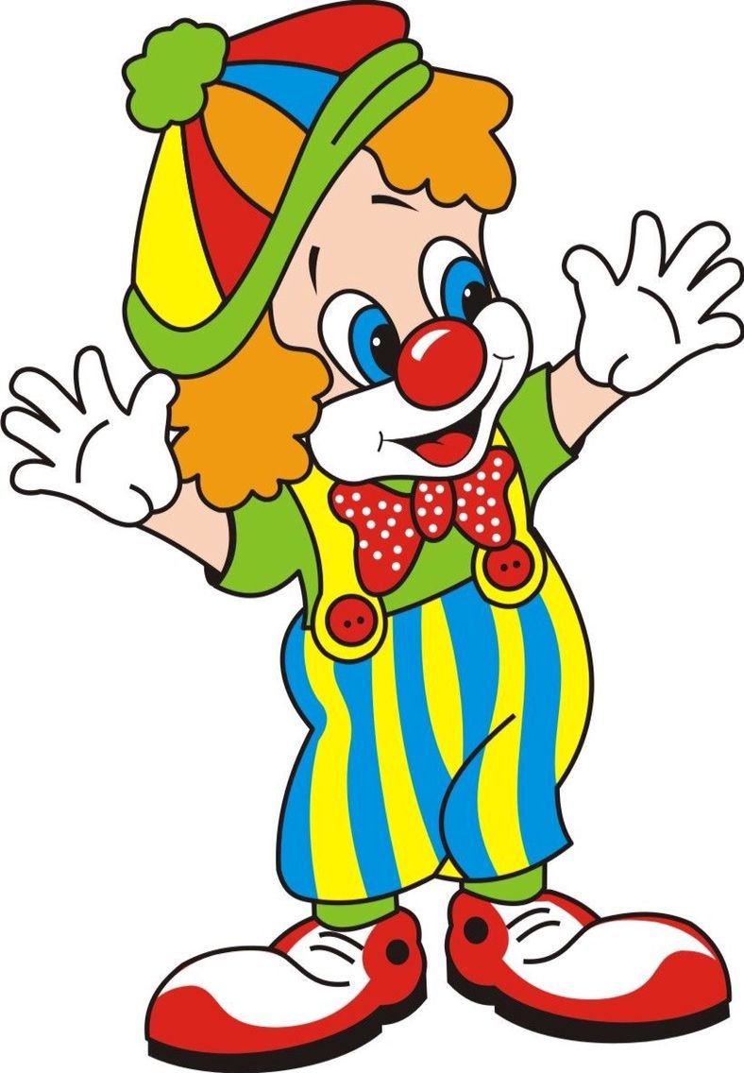
Hello! I am Tom. And what’s your name?

Slide 4




Slide 5
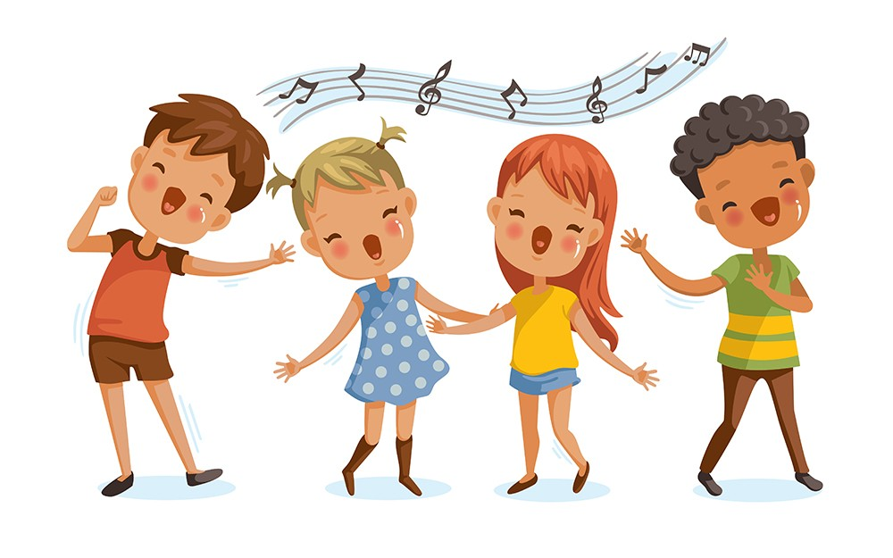
My name is … .

Slide 6

Well done!
2

Slide 7
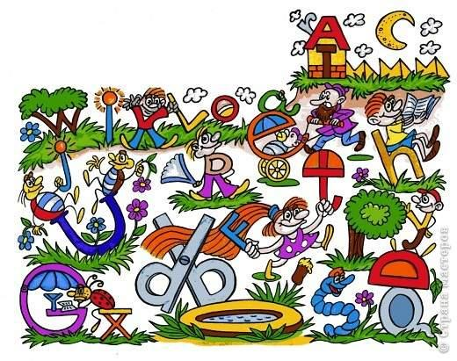

Slide 8
Well done!
2 | 5

Slide 9

Are you tired?

Slide 10
Great!
2 | 5 | 1

Slide 11

Work in pairs!
Let’s play!

Slide 12

3
6
2
4
1
5

Slide 13
Good job!
2 | 5 | 1 | 3

Slide 14


Slide 15

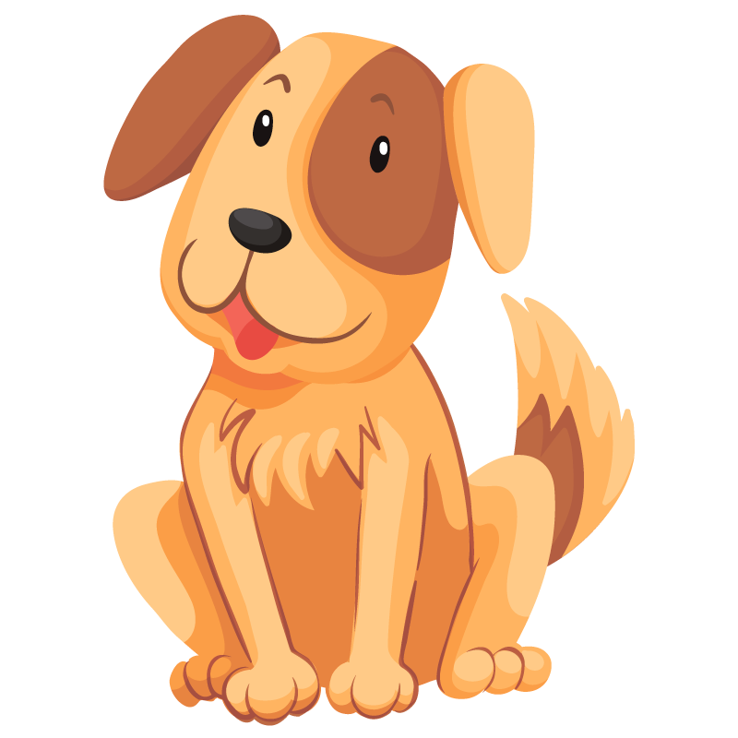
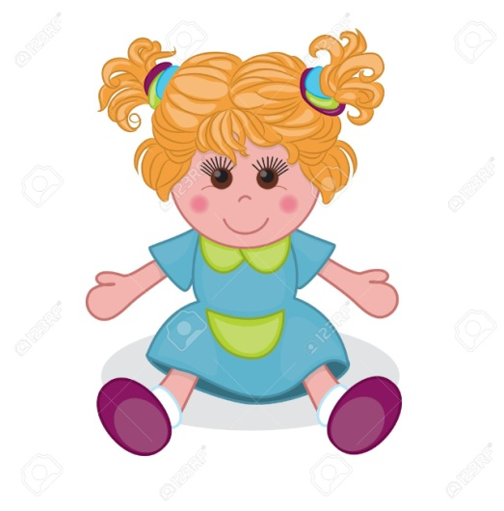

Slide 16
Thank you girls and boys! We have a great time! Goodbye!

Slide 17
На уроке я узнал (а) … .
Было интересно … .
Меня удивило … .

Slide 18

«Экран эмоций»

